Slide 1
AI @ Touring

Slide 2
AI Powered Assistant for Call Center Operators
In collaboration with B12 consulting | part of Yuma

Slide 3
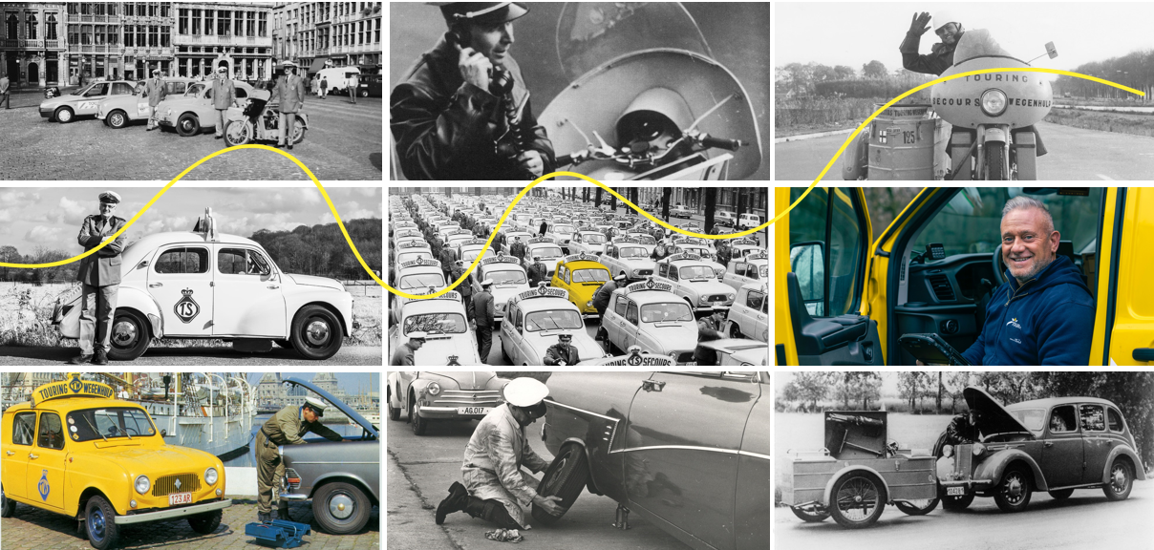
Touring – A History

Slide 4
Touring – Our Core Business
Roadside Assistance
Medical Assistance
Travel Assistance
Mobility & Traffic

Slide 5
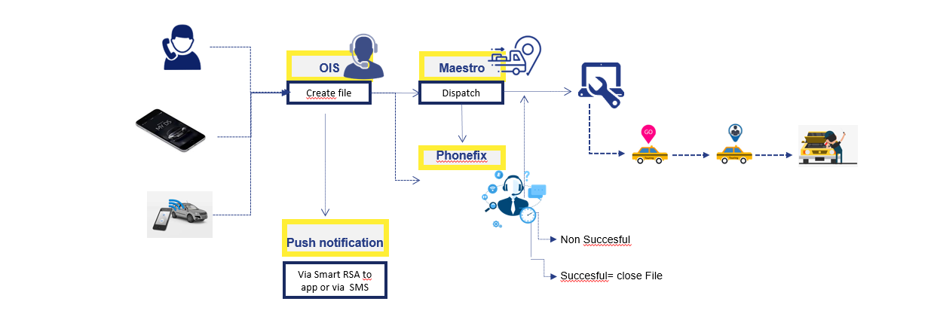
Touring – Our Current process

Slide 6
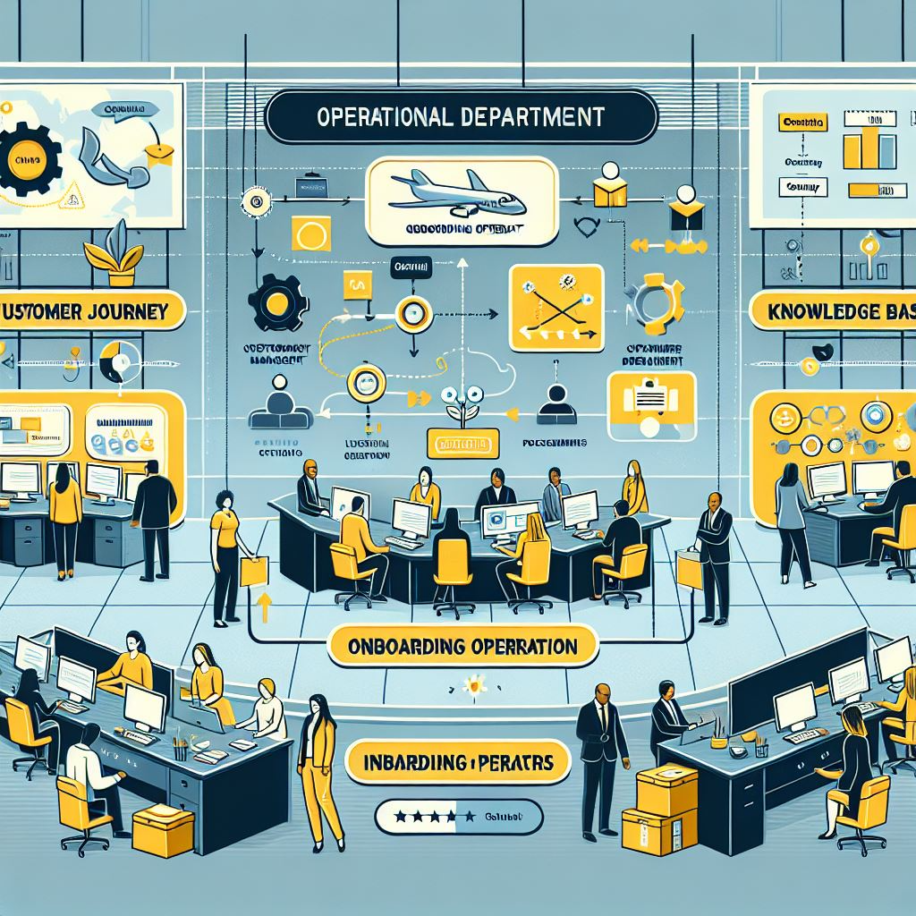
Touring – Our Challenges
« I am sorry, I am new and have to ask my colleague »
« Of course Mr. Dupont, I am not sure but please hold the line while I check for you »

Slide 7
When you are in trouble, the only words you need to hear are
“It’s going to be OK”

Slide 8
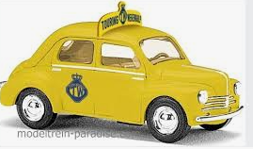
Touring – The road to an AI solution
Strategy
Competiton & Differentiation
Collaboration with B12 | Part of Yuma

Slide 9
Enter TourAssist: An AI powered assistant

Slide 10
TourAssist: Demo current

Slide 11
TourAssist: Demo TourAssist Bot

Slide 12
TourAssist: Innovative Architecture Beyond a Standard RAG !
Non standard features
Retreiver AI agent obtains text from the KB which is deemed relevant for the question (context aware, multilingual, multimodal …)
Call agents ask questions via a chatbot
LLM formulates an answer from the retreived text and the original question (i.e. given the knowledge base, answer the question)
?
User friendly Interface (UI) - Chatbot
Clarifications are injected into the KB
Knowledge Base (KB)
UI allows domain experts to input clarifications and corrections so the chatbot can “learn”
LLM encodes the documents
Answer is fed back to the user
Textual documents are uploaded into the KB

Slide 13
TourAssist: Adoption of the tool

Slide 14
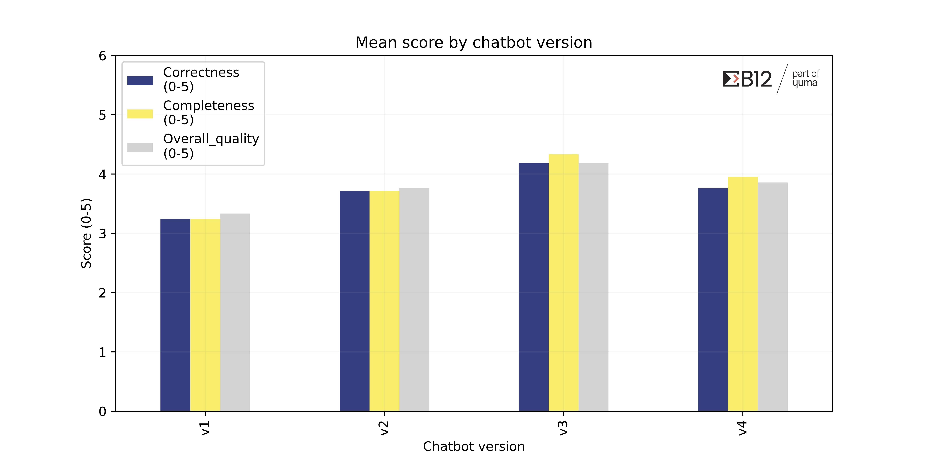
TourAssist: Human evaluation remains the golden standard in chatbot evaluation
So far we have tested 4 different approaches to information retreival and answer formulation with expert feedback being crucial to guide technology choices
Chatbot version “C”:
median answer grade of 5 (out of 5)
30% higher quality answers compared to the first version of the chatbot

