Slide 1
Reducing Embracing/Managing Complexity
CIONet Community Event
Marnix Gillis
June 18, 2024
1

Slide 2
Outline | Agenda
Business Challenges and Goals
The new Buzz word: ModernOps
An Integration platform: “Kyndryl Bridge”
(Proven) Customer Value
2

Slide 3

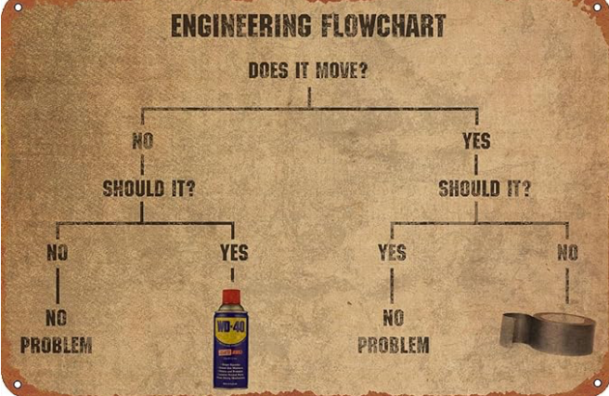



​​​​​​​​​​​​​​I-AIOPs maximizes the value of intelligent automation, self-service & actionable insights for Kyndryl delivery.
Business challenges we see in the market
Complexity Management
Incident Response and Resolution
Complexity is the rule, not the exception
People very often use what they are familiar with
The increasing complexity of modern (integrated and hybrid) IT environments poses a significant challenge for businesses, leading to difficulties in managing and optimizing operations effectively.
Incident response and resolution processes in IT operations are often slow and inefficient, causing prolonged downtime and service disruptions that negatively impact business operations and customer satisfaction.
Continuously Proactive, instead of Reactive
Data Overload and Noise Reduction
Wasn’t that the whole idea of Tivoli Enterprise Console or CA Unicenter or …
“You never know enough”, really? How about relevance?
Utilize AIOps to proactively identify potential issues and opportunities for improvement in customer end-to-end business application environments
Businesses are inundated with vast amounts of data from various sources, leading to information overload and noise that hinder effective decision-making and resource allocation in IT operations.

Slide 4
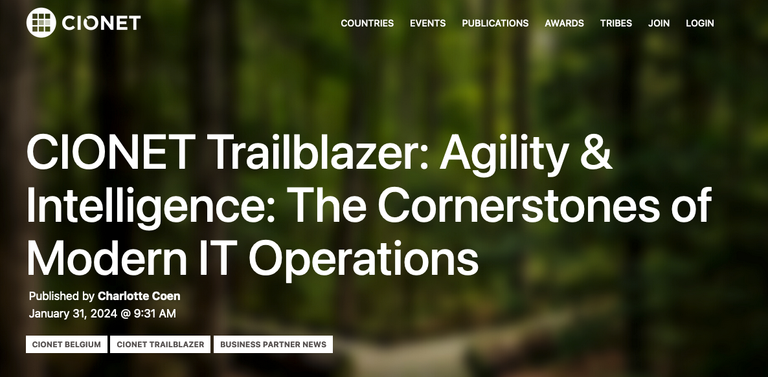
The Solution – Modern Ops
https://www.cionet.com/news/agility-intelligence-the-cornerstones-of-modern-it-operations

Slide 5


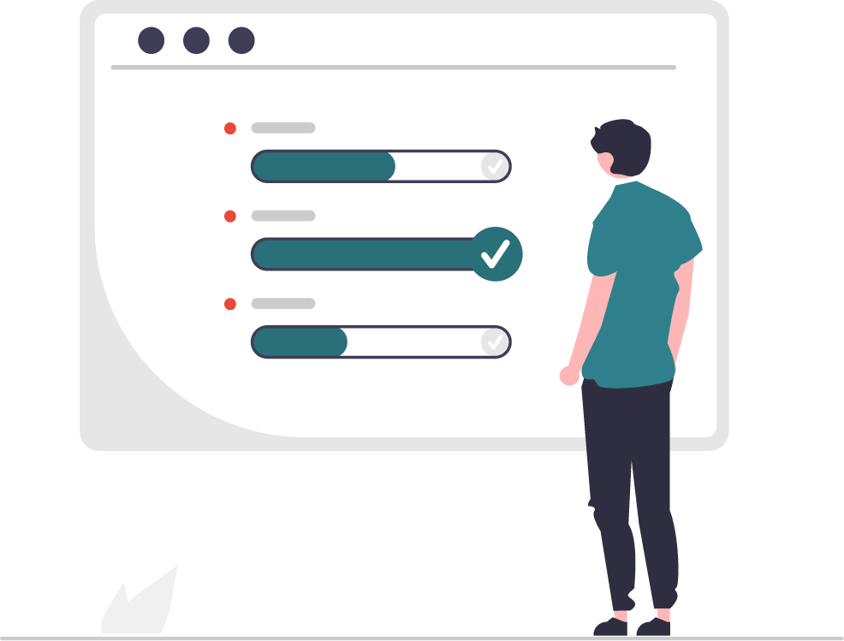
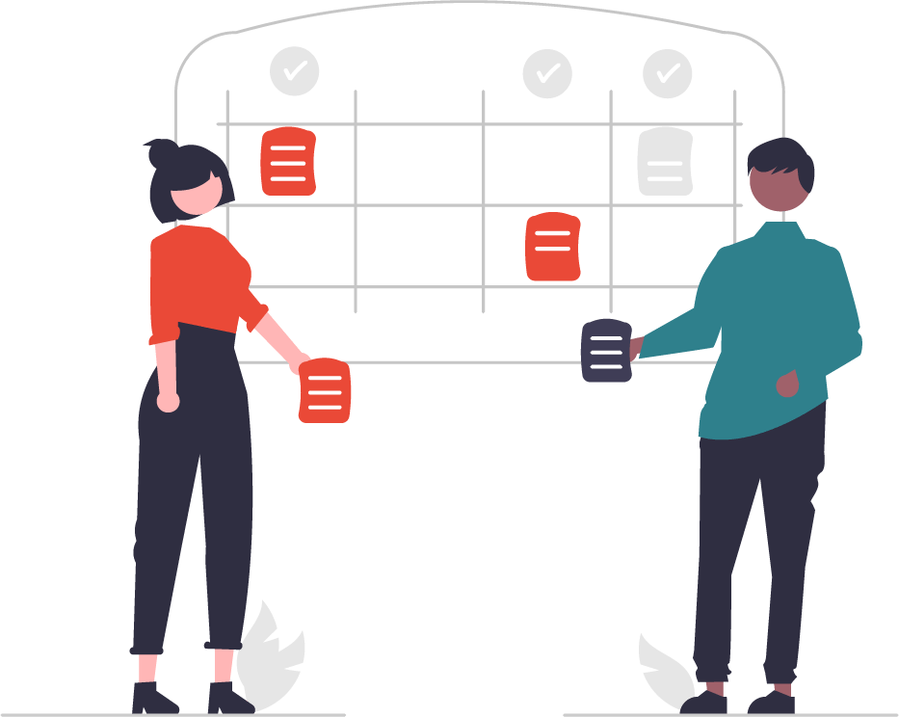
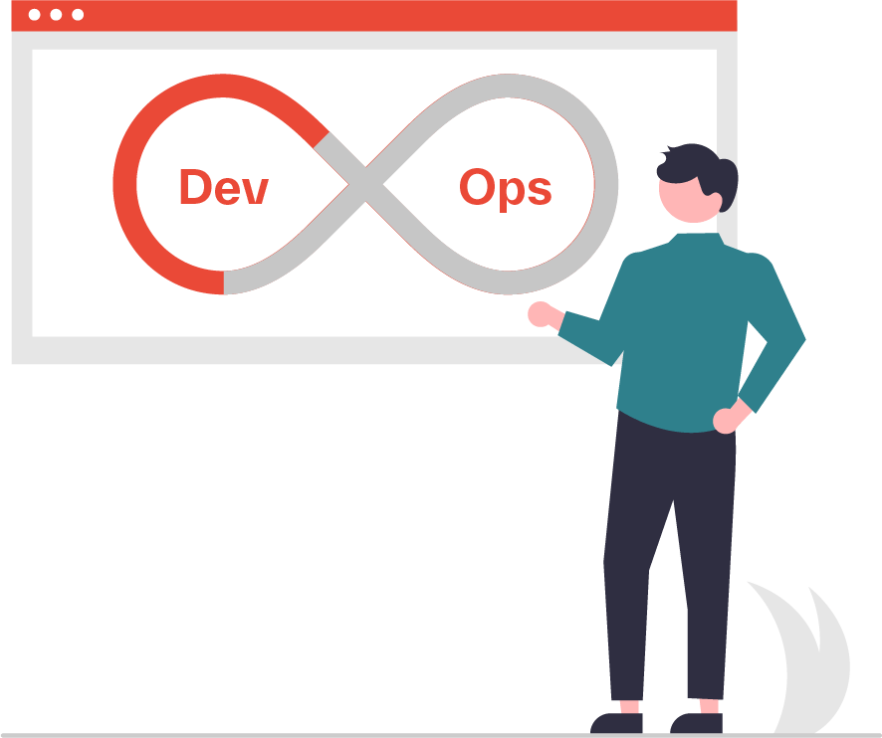

We implemented this with an integration platform, called “Kyndryl Bridge”
Optimize
Cloud Costs
FinOps
Ensure
Security Posture
CompSecOps
AI Operations
Customer Outcomes
AIOps
Kyndryl Bridge
The One Integration Platform for IT Services
Orchestrate
Deployments
CloudOps
Automate
Pipelines
DevOps
Achieve
Net-Zero
SustainabilityOps
5

Slide 6





Kyndryl Bridge AIOps accelerates value
At Scale
Automated data ingestion across estate reusing customer investment and reducing complexity
Continuously Proactive
Utilize AIOps to proactively identify potential issues and opportunities for improvement in customer end-to-end business application environments
Actionable Insights
Faster decision with instant focus to critical items embedding SME knowledge
Cost Optimization through Autonomic Response
Automation
Utilize AIOps to quickly solve issues that are occurring with no human intervention and limited to no impact.
Recommended automation deployment reducing downtime and improving compliance posture
(Generative) AI
Prevent impact by Best Practice Enforcement
Platform and customer driven insights on data and knowledge base across multiple customers
Implement policy-based automation and orchestration to implement guardrails and standards across entire business application environment. (“Hard to do Harm”)
Delivery Runs On Bridge
Embedded in the operational model supporting Co-Managed for Customer success
6

Slide 7
Kyndryl Bridge AIOps | Integrate without ‘any’ development
Reusing investments customer already made in their IT management solutions
AI/ML Actionable Insights & Visualization
Ability to prevent issues before they occur. Faster mean time to restore via AI powered insights.
Best Practice Policy Evaluation
Alignment of devices to Kyndryl and industry best practices.
Capacity and Performance Management
Identifies devices not having capacity per best practice to be addressed to avoid business customer impact.
Inventory, Reporting and Analytics
Single truth of source for inventory (not CMDB)
Preventive tracking and management of EOS/EOL lifecycle.
Kanban Single Funnel of Work
Workload Balancing and employee engagement.
ITSM ticket data and Events
Outage avoidance by improving Mean time to detect and Mean time to restore. Ticketing system to provide Incident, Problem, Change and Service Request data.
ChatOps DevSecOps Communication
Modern system of engagement for employees and Squad.
APM Observability
Aplication Performance monitoring and digital end user experience.
Extension Services
Automation Platform and Data Collection
Efficiencies by removing toil and faster mean time to restore (event automation). Also running playbooks to gather information such as SSL Certificate expiration, Health Check and Patch status information.
Extensions integration ingesting data sources at scale across the estate
Any information via logs and APIs
Other information that is available and more.
7

Slide 8
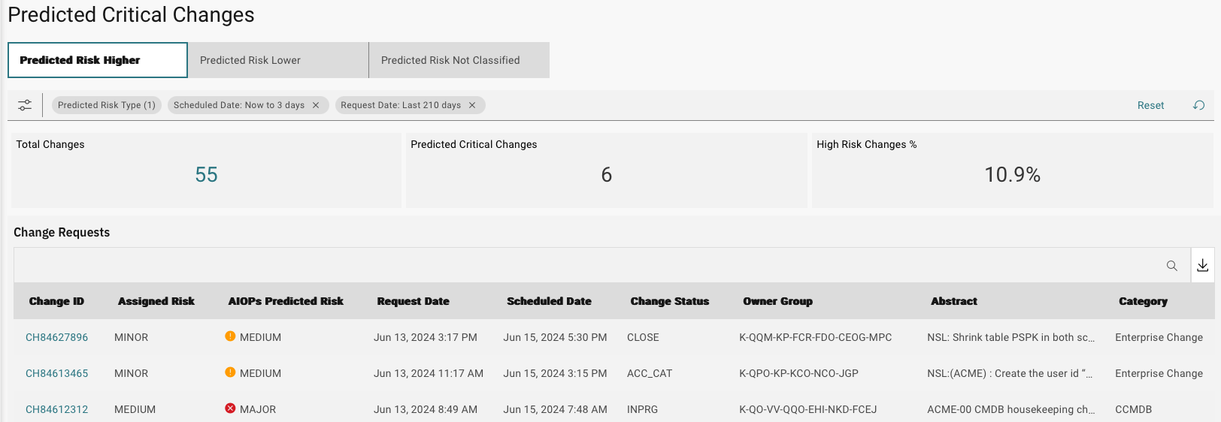
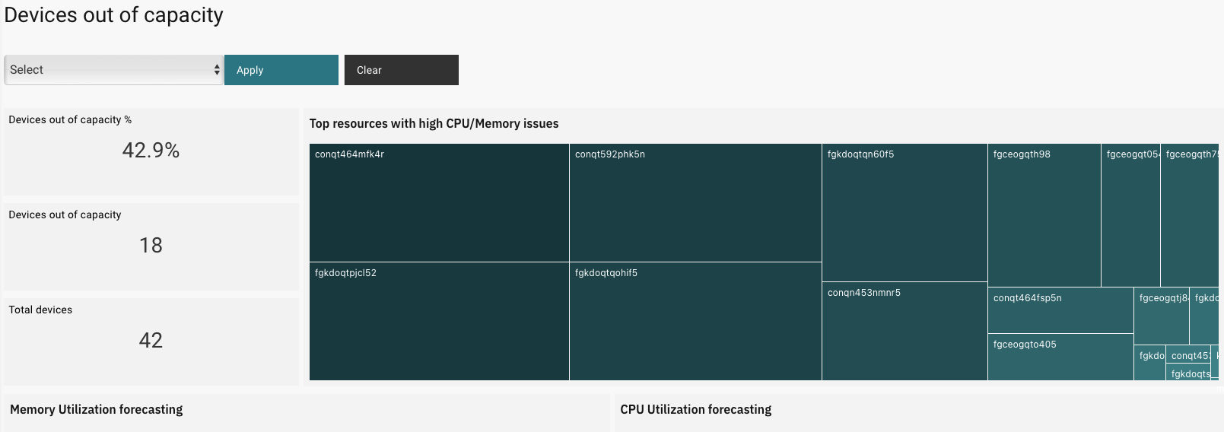
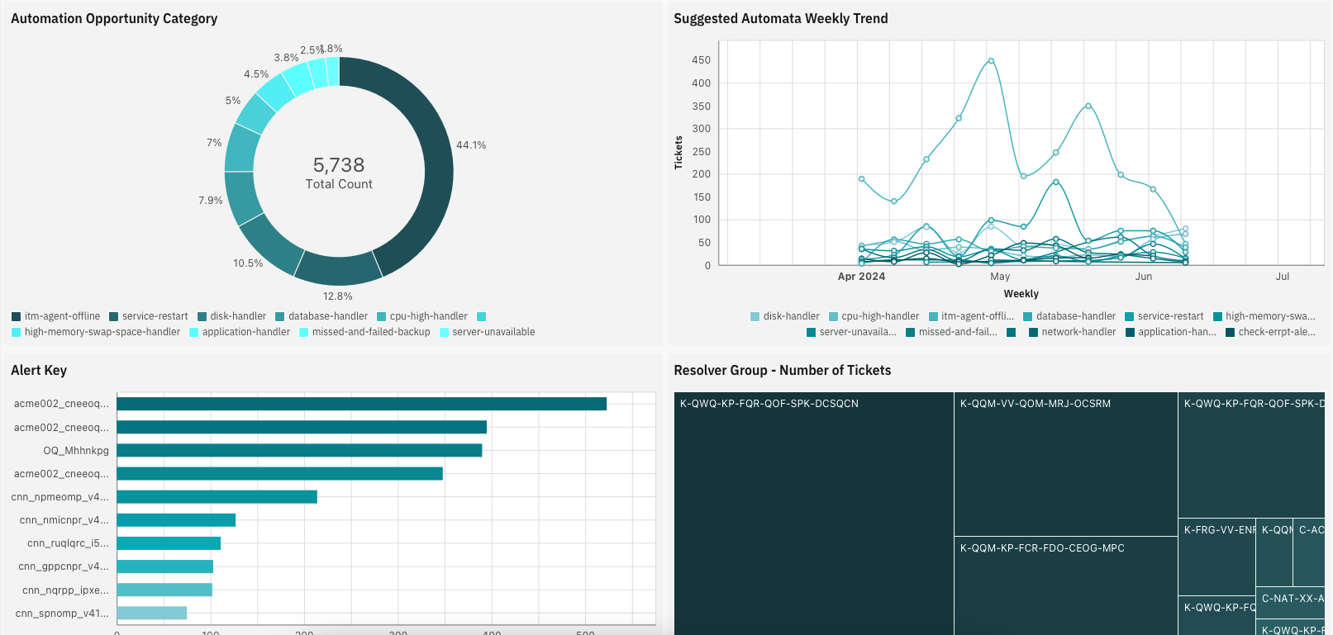
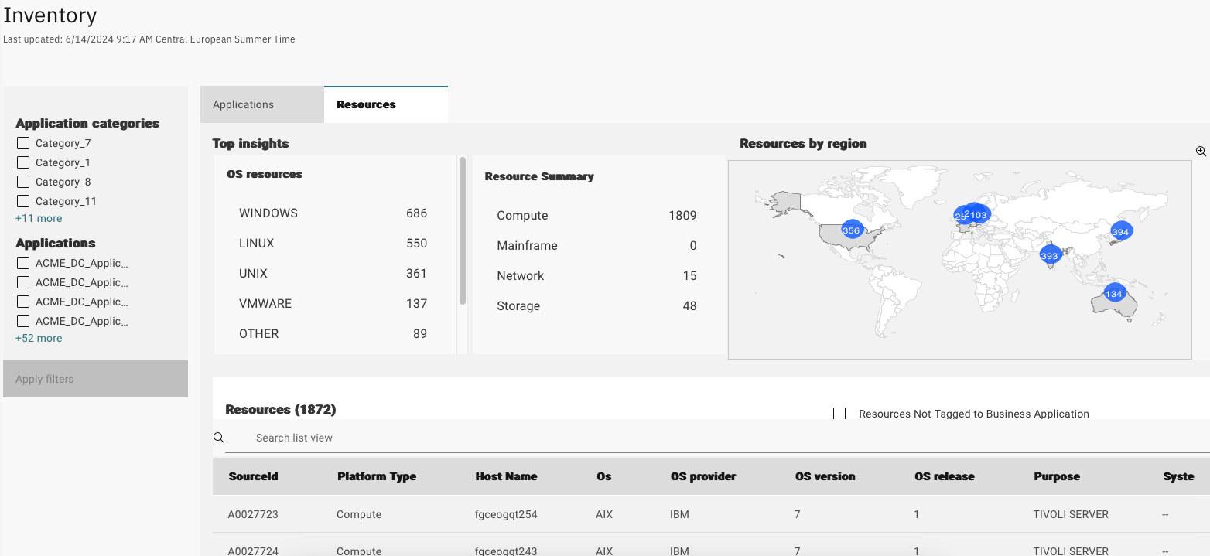
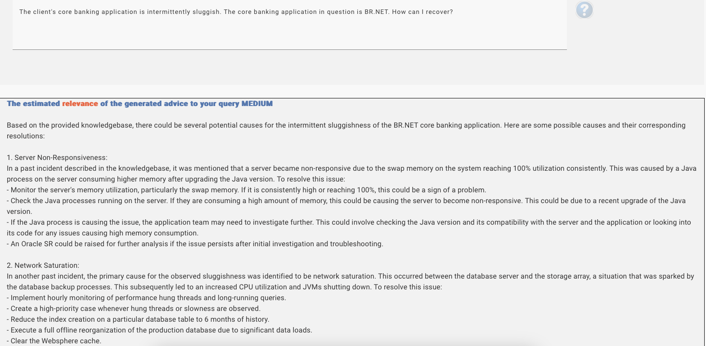
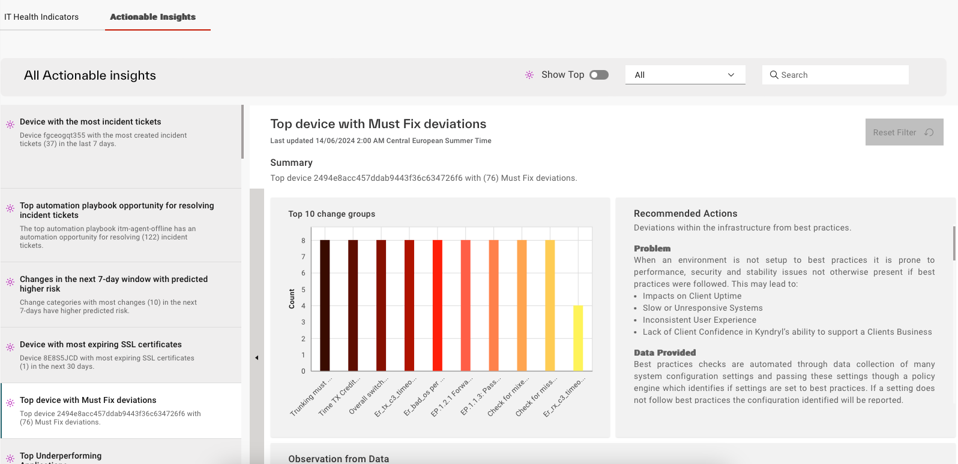
Some screenshots

Slide 9
One year later
Client Value
Act with transparency
Our customers can get access to Integrated AIOps:
1200* customers boarded
All Belux customers are boarded
Figures:
100 million+ automations per month
Improved Net Promoter Score (NPS)
63% in Belux
45%
Incident reduction
34%
MTTR reduction
Up to
96%
Reduction in recurring application issue
Up to
31%
Initial reduction in capacity related incidents
And I have a more quiet weekend ;-)

Slide 10
Questions?

Slide 11
Thank You!
11

