Slide 1
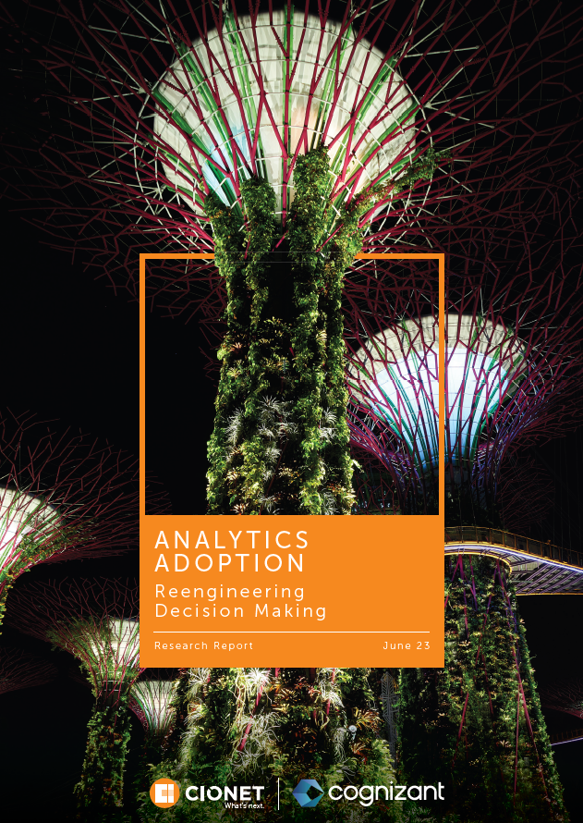
CIONET Belgium
A Smarter Business
15 June 2023

Slide 2
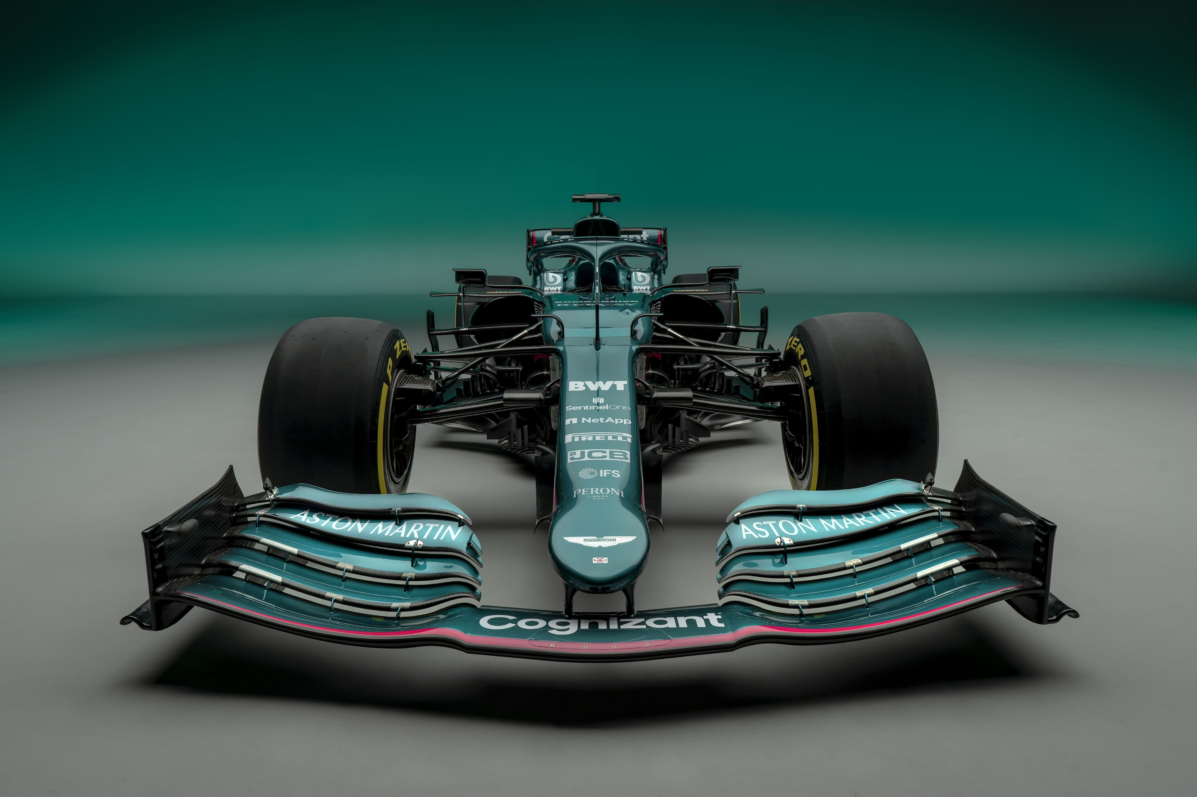
Bart Moens
Director Data & AI

Slide 3
Organisations embracing analytics achieve more

Slide 4
Organisations embracing analytics achieve more
Increased level of analytics adoption
Incorporated analytics in decision making

Slide 5
Organisations embracing analytics achieve more
Increased level of analytics adoption
Incorporated analytics in decision making
#26 interviews

Slide 6
Organisations embracing analytics achieve more
Increased level of analytics adoption
Incorporated analytics in decision making
#26 interviews
Research report

Slide 7
Organisations embracing analytics achieve more
Increased level of analytics adoption
Incorporated analytics in decision making
#26 interviews
Research report
Impact of the CIO
4 key findings of the study

Slide 8
Good News
Bad
News
There is nothing new
There is nothing new

Slide 10
Strategic
= Role of the CIO
Modern Data Platform
Enabling Analytics
Use case driven

Slide 11
Use
Cases
Data
Technology

Slide 12
Analytics culture
Use
Cases
Data
Technology
Notes:
Ignite the new way of working
Incorporate decision making in day to day work
Organisation embracing analytics
Pull to push
Ignition and engine for new use cases
CIO as the leader, but in combination with the data organizations: data stewards or data promoters

Slide 13
< Pull
Push
Data
Technology
Use
Cases
Value

Slide 14
Productise
Data
Technology
Use
Cases
Value
Notes:
Productize the data platform
Govern the use cases – Prioritize on the value generated for the organization

Slide 15
Balancing the new way of working
Enabling a use case driven value engine
Data
Use
Cases
Value
Technology

Slide 16
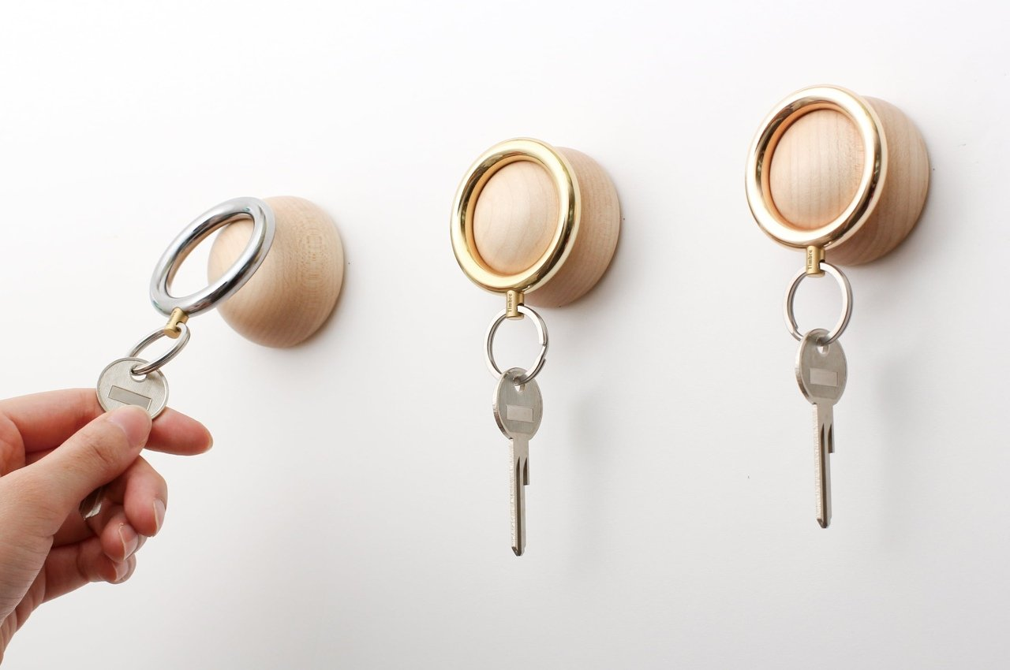
1
2
3
4
Notes:
Our 4 recommendation from our study
Know that we have study with more insights

Slide 17
1
Self-service drives adoption
Higher adoption rates
Use case driven
Human centric design
2
3
4

Slide 18
1
Valuefication
Self service drives adoption
Business value
Value in analytics
supply chain
Contribution value
2
3
4

Slide 19
1
Self service drives adoption
Less is more
Less data marts
Less perfection
More output
2
3
4

Slide 20
1
Self service drives adoption
Human wisdom &
artificial intelligence
Power of AI
Human intuition and context
Harmonious blend
2
3
4

Slide 21
Our key take aways for today
1
Self service drives adoption
2
Self-service drives adoption
Valuefication
Valuefication
3
Less is more
4
Human wisdom &
artificial intelligence

